Slide 1
An overview of the solution to uniform digital services at JLU
Hao Xu
JLU
DIGITAL UNIVERSITY
－－－－－－－－－－－－－－－－－－－－－－
The original version of these slides was prepared by Vincenzo Maltese based on the work on the Digital University Project at the University of Trento

Slide 2
JLU
DIGITAL UNIVERSITY
CONTEXT

Slide 3
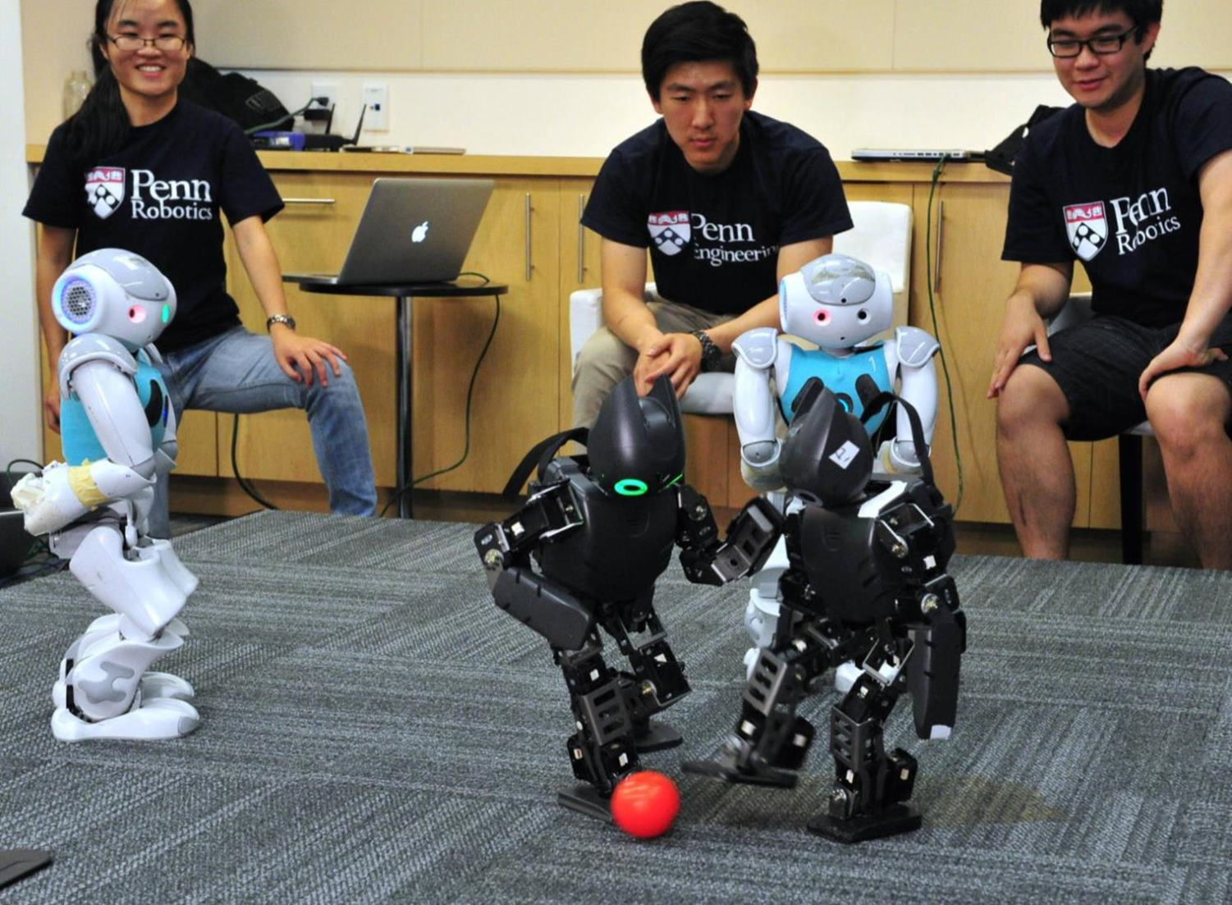
Context: the University ecosystem
Producing knowledge with research

Slide 4
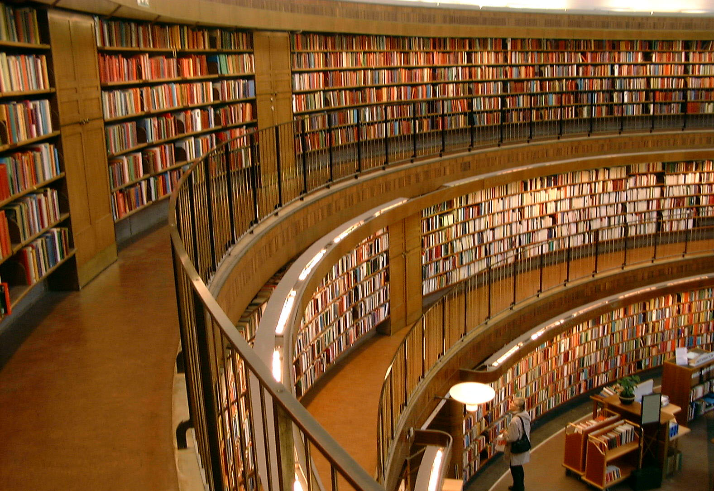
Context: the University ecosystem
Preserving knowledge in (digital)
libraries

Slide 5
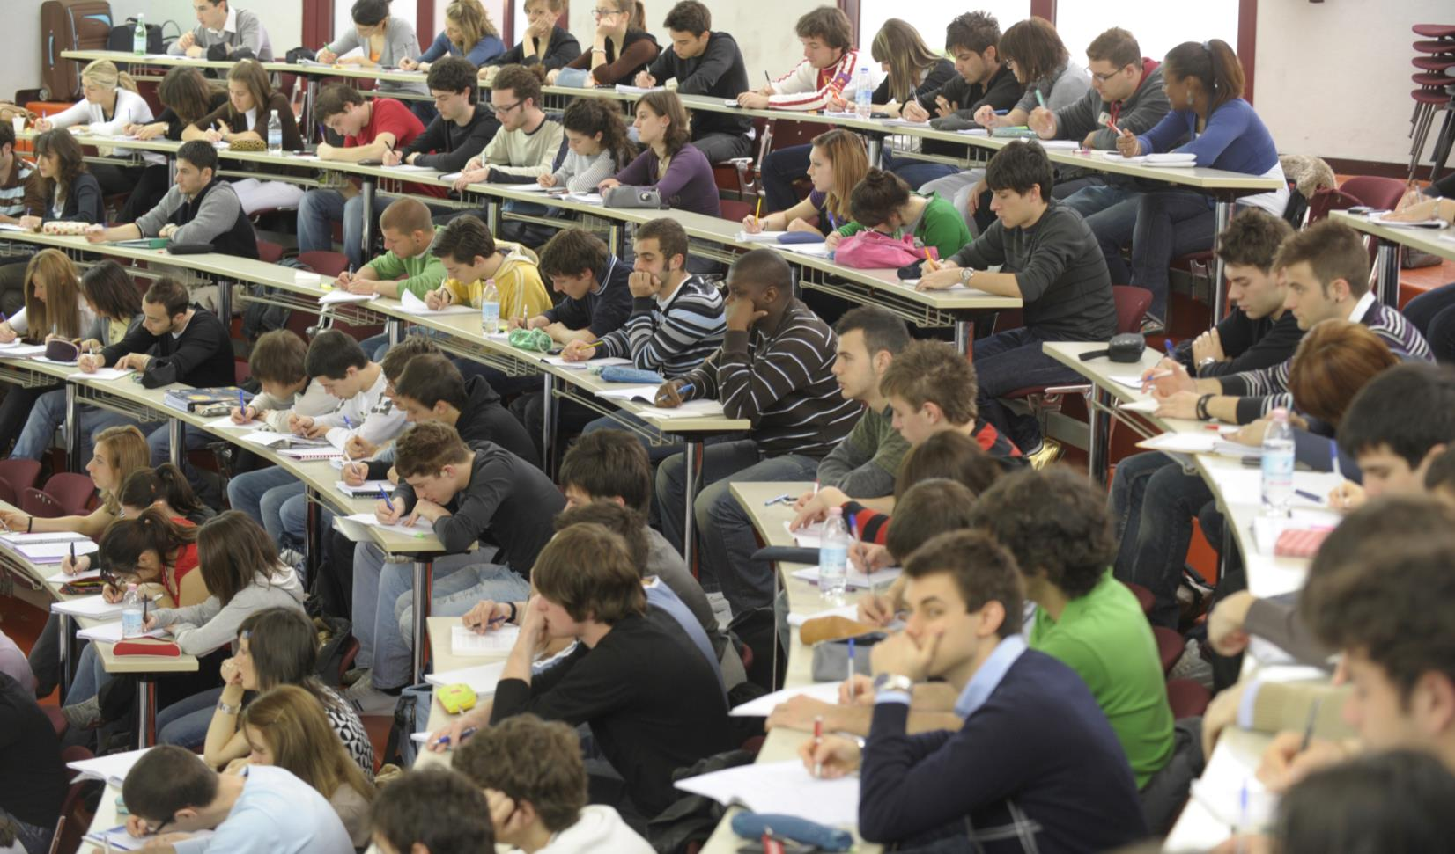
Context: the University ecosystem
Consuming knowledge with
courses

Slide 6

Context: the University ecosystem
Transferring knowledge to industries

Slide 7
JLU
DIGITAL UNIVERSITY
CHALLENGES

Slide 8
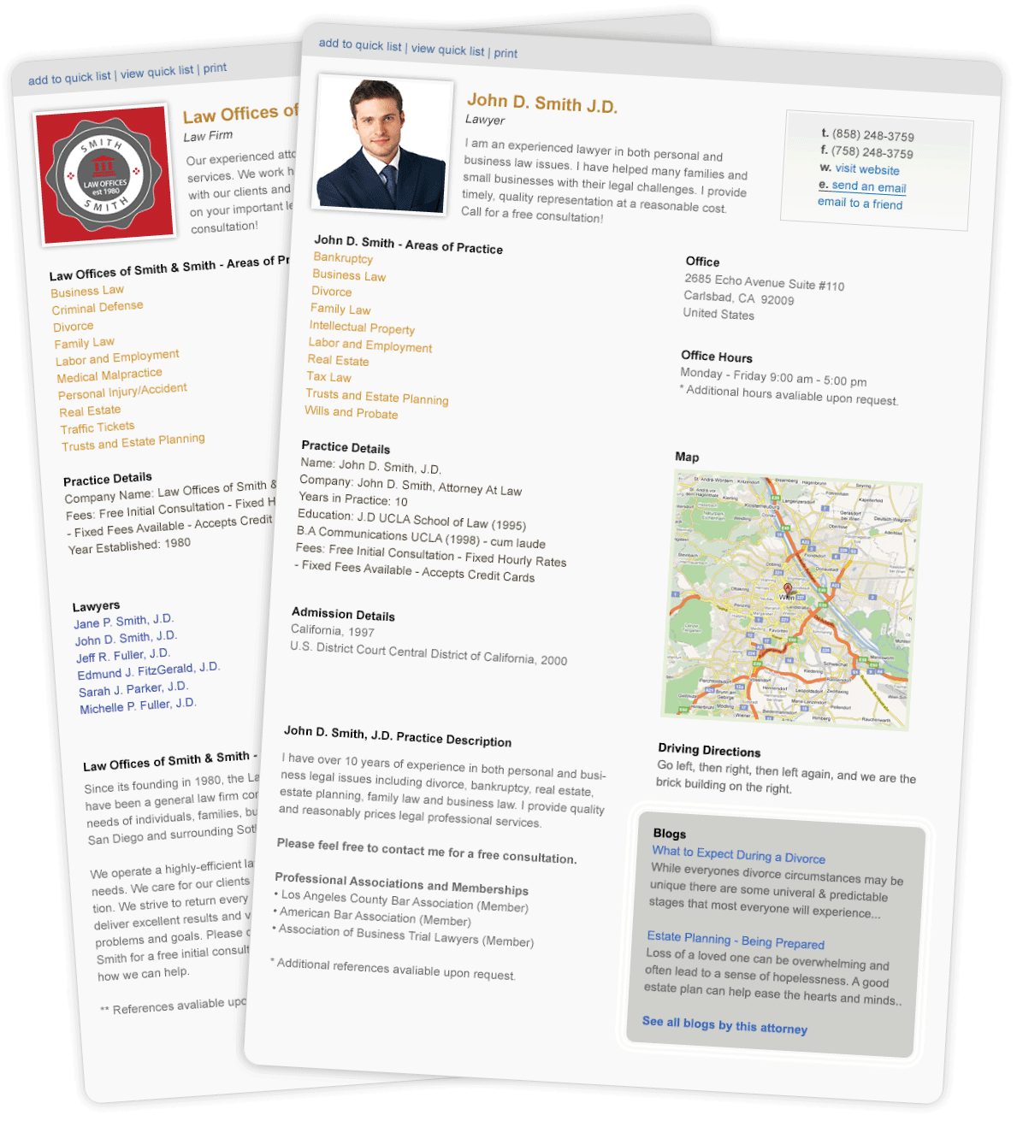
Challenges: to ensure national and international promotion
A huge variety of entities:
Publications
Courses
Projects
Facilities
Offices
Professors
Students
…

Slide 9

Challenges: to comply with regulations

Slide 10




Challenges: streamlining internal processes
Evaluate department performance, reporting, annual reviewes, …...

Slide 11
JLU
DIGITAL UNIVERSITY
DIFFICULTIES

Slide 12

Difficulties: data is “opaque” or difficult to access

Slide 13
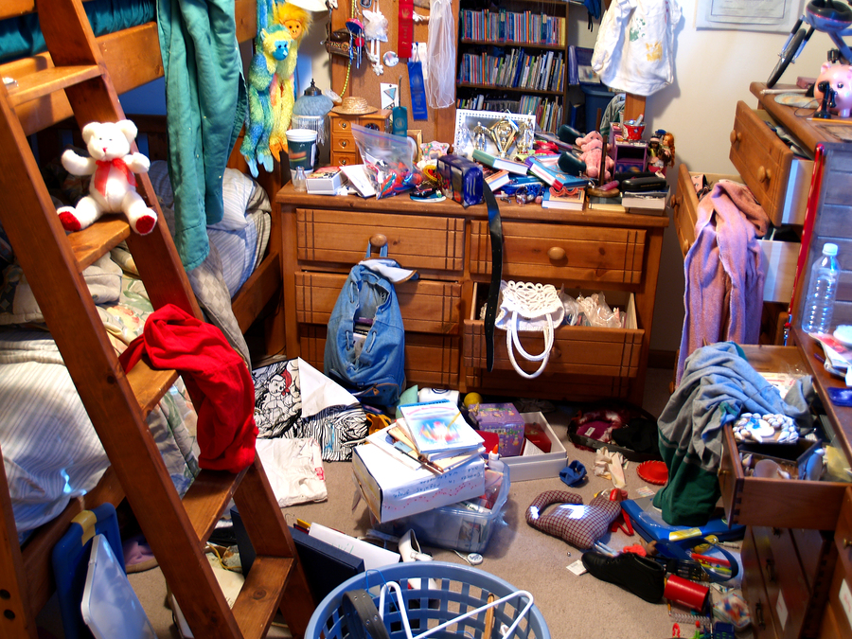
Difficulties: data is messy

Slide 14
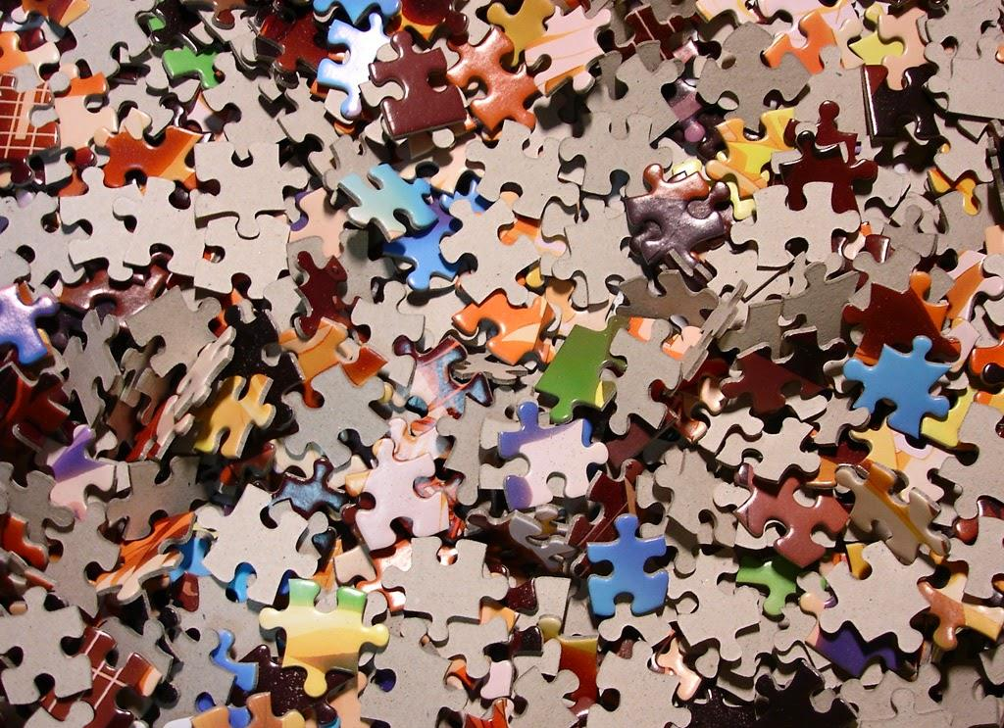
Difficulties: data is fragmented and difficult to pull together

Slide 15

Difficulties: Digital Libraries only focus on publications
Notes:
数字图书馆是否需要新图

Slide 16
JLU
DIGITAL UNIVERSITY
SOLUTION

Slide 17

Solution: from Digital Libraries to Digital Universities

Slide 18

Solution: to collect, integrate, and master information

Slide 19
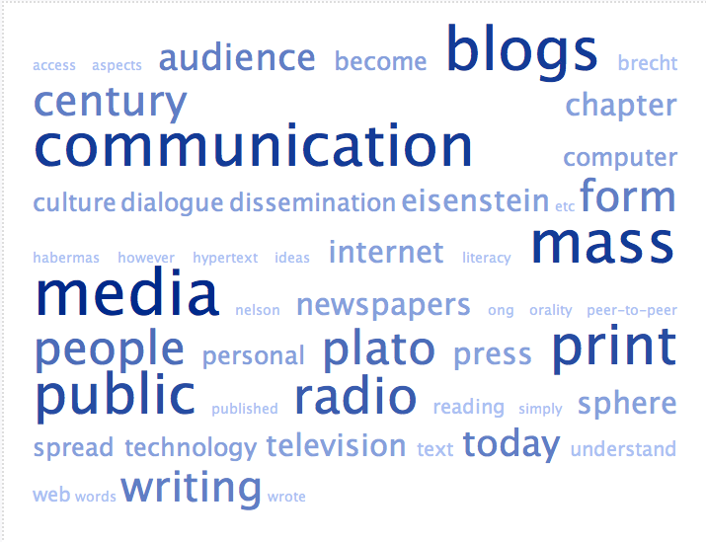
Solution: to organize University knowledge assets
Projects
Professors
Expertize
Papers
Courses
Students

Slide 20
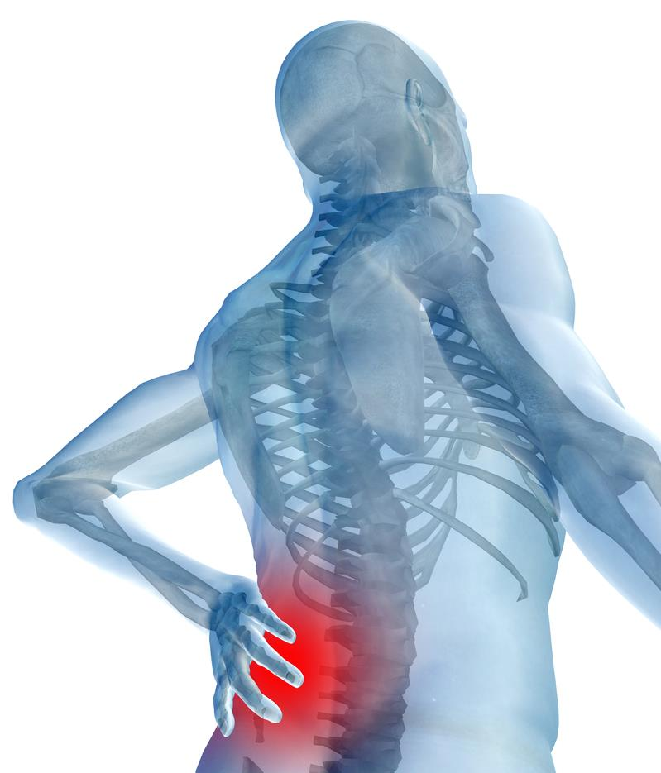
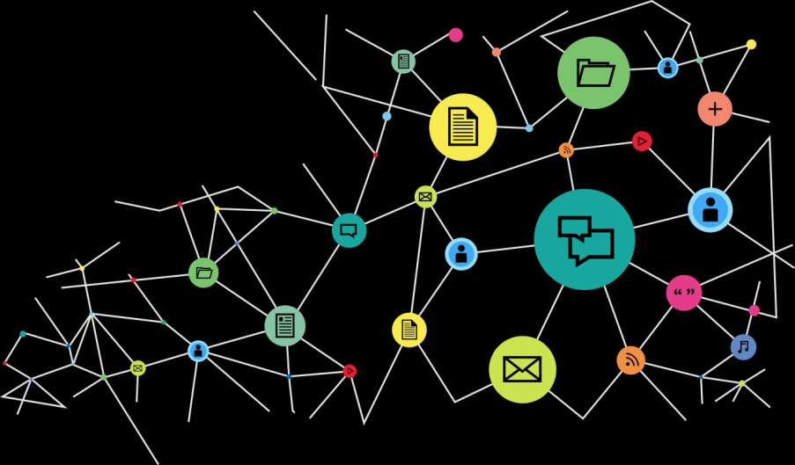
Solution: to develop the University “nervous system”
Sense, collect, elaborate, trasmit, act!

Slide 21
JLU
DIGITAL UNIVERSITY
ADDRESS THE CHALLENGES

Slide 22
Solution: to ensure effective and consistent promotion

Slide 23

Solution: to comply with national regulations

Slide 24
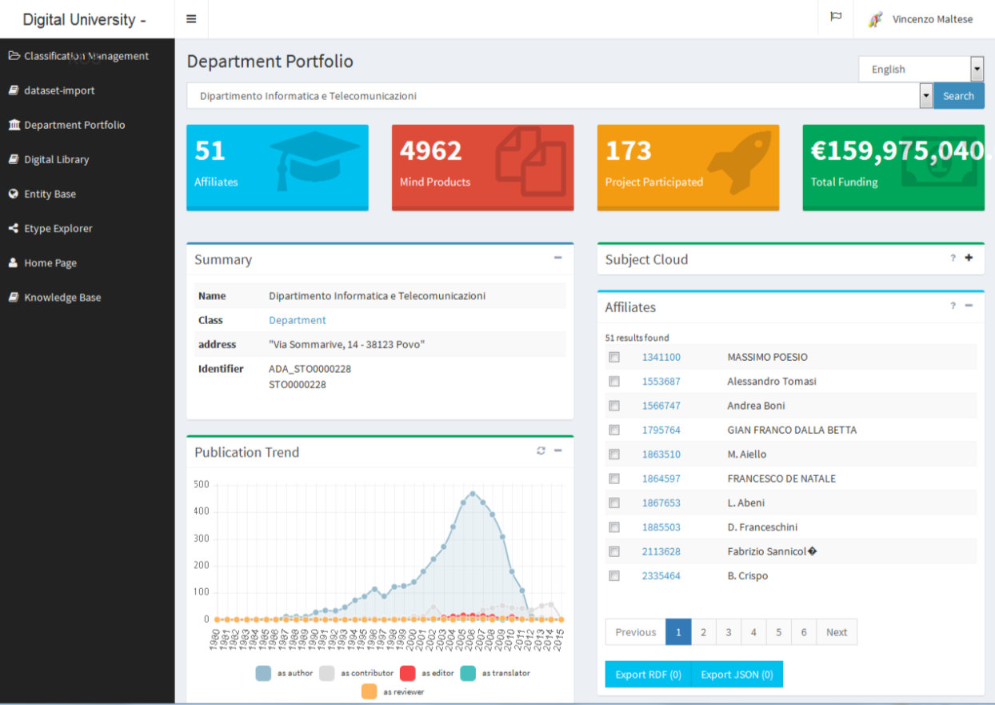
Solution: to streamline internal processes

Slide 25
Solution: key impacts of Digital University in SUSTech
A scalable, ease to use and secure IT infrastructure
Ability to organize and govern key knowledge assets of the University
Ability to support multiple digital services
Multilingual University Websites
University Dashboards
Advanced and timely reporting
Notes:
Digital services需要改

Slide 26
JLU
DIGITAL UNIVERSITY
TECHNOLOGICAL SUPPORT

Slide 27










Technology: a scalable and configurable IT infrastructure

Slide 28
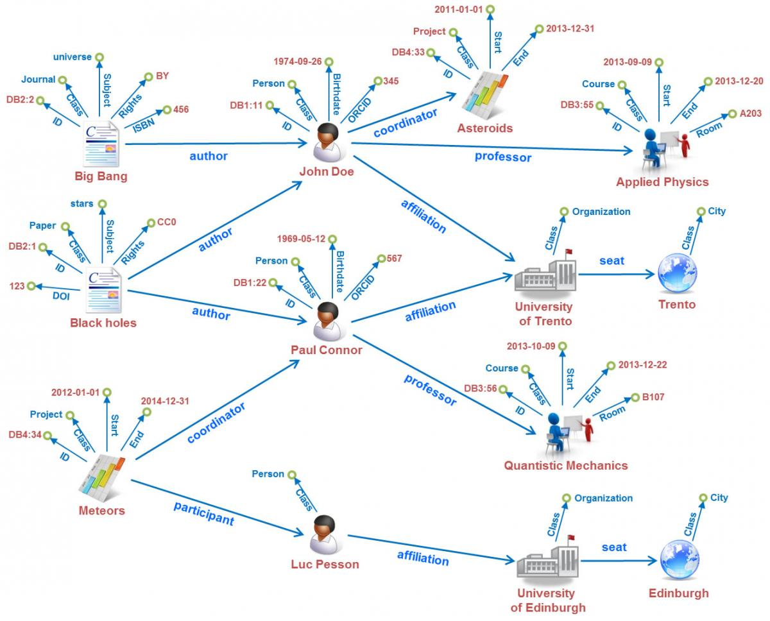
Technology: knowledge graphs

Slide 29
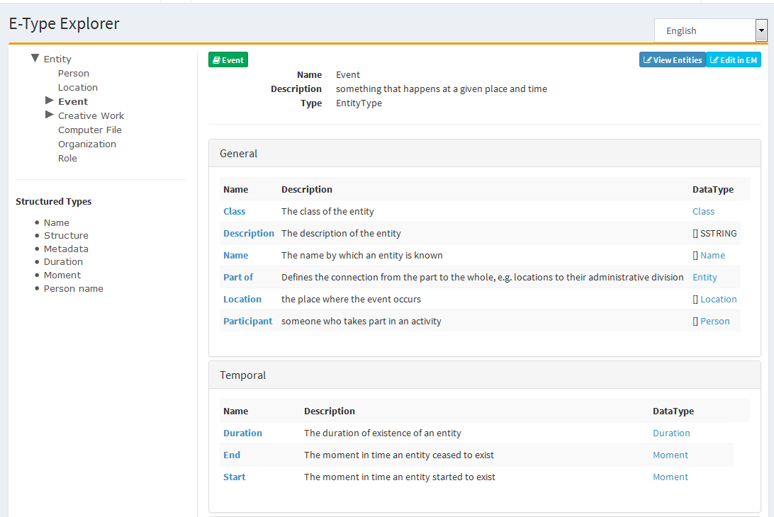
Technology: dashboards for the Data Scientist (1)
Data model definition and browsing

Slide 30
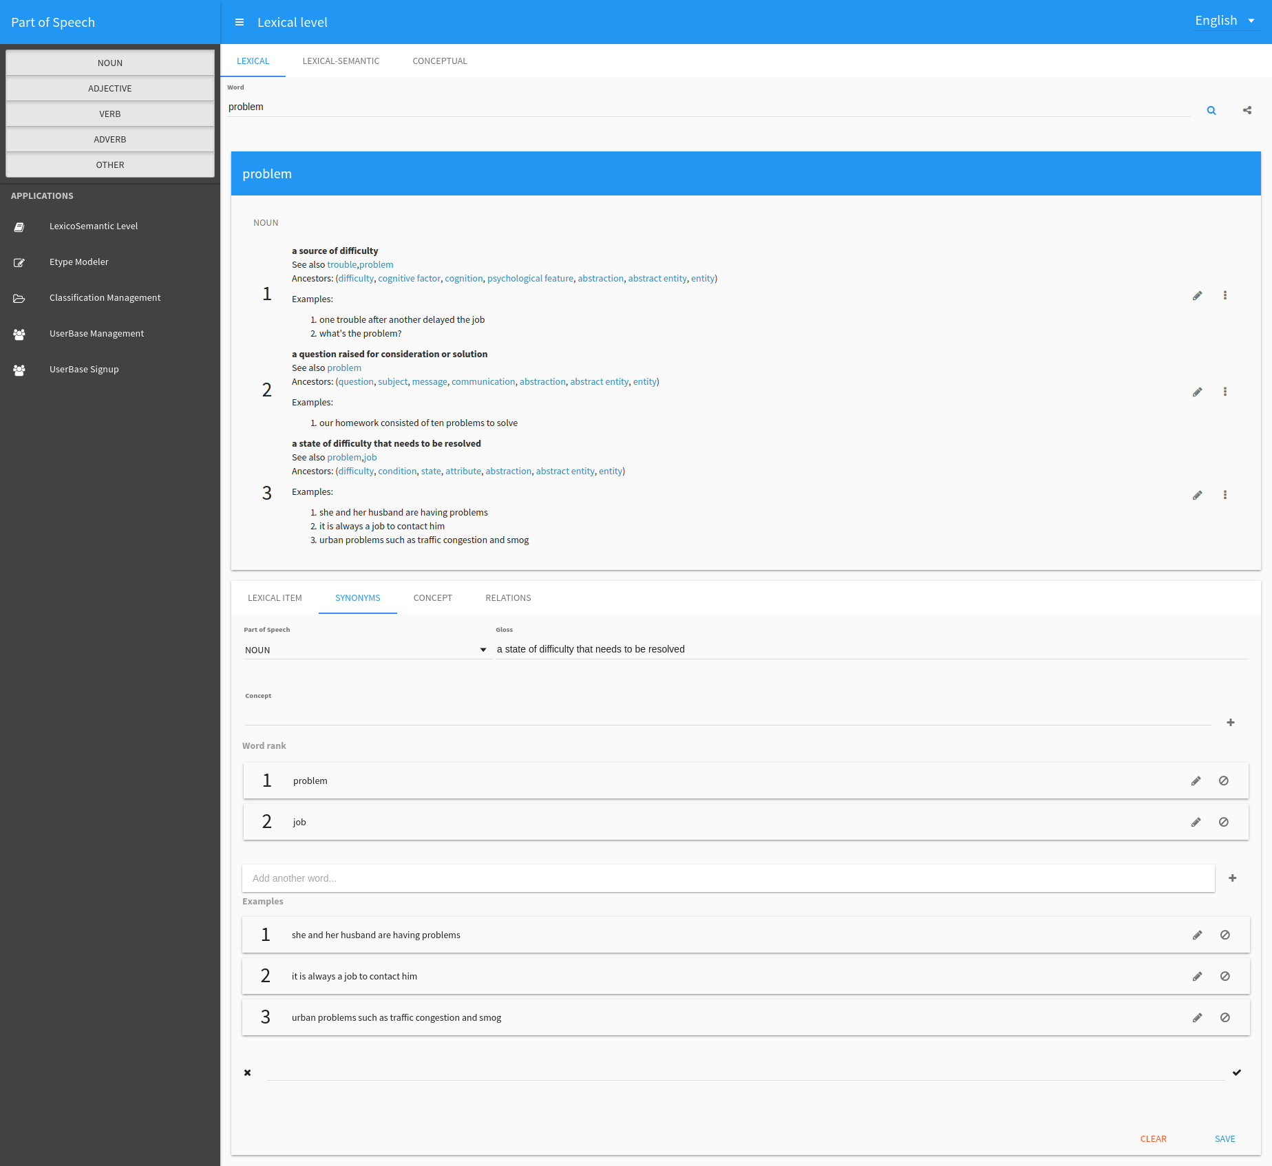
Technology: dashboards for the Data Scientist (2)
Vocabulary browsing

Slide 31
Technology: dashboards for the Data Scientist (3)
Vocabulary definition

Slide 32
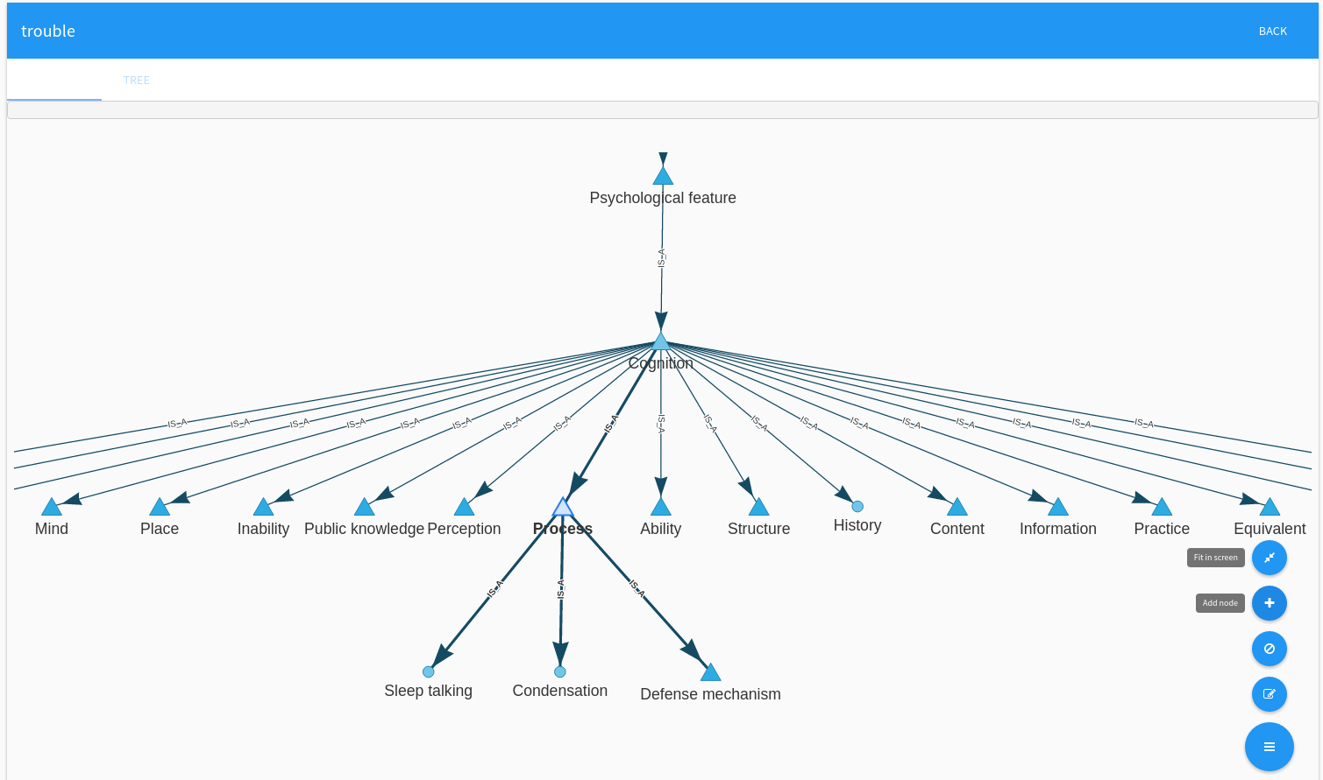
Technology: dashboards for the Data Scientist (4)
Vocabulary definition

Slide 33
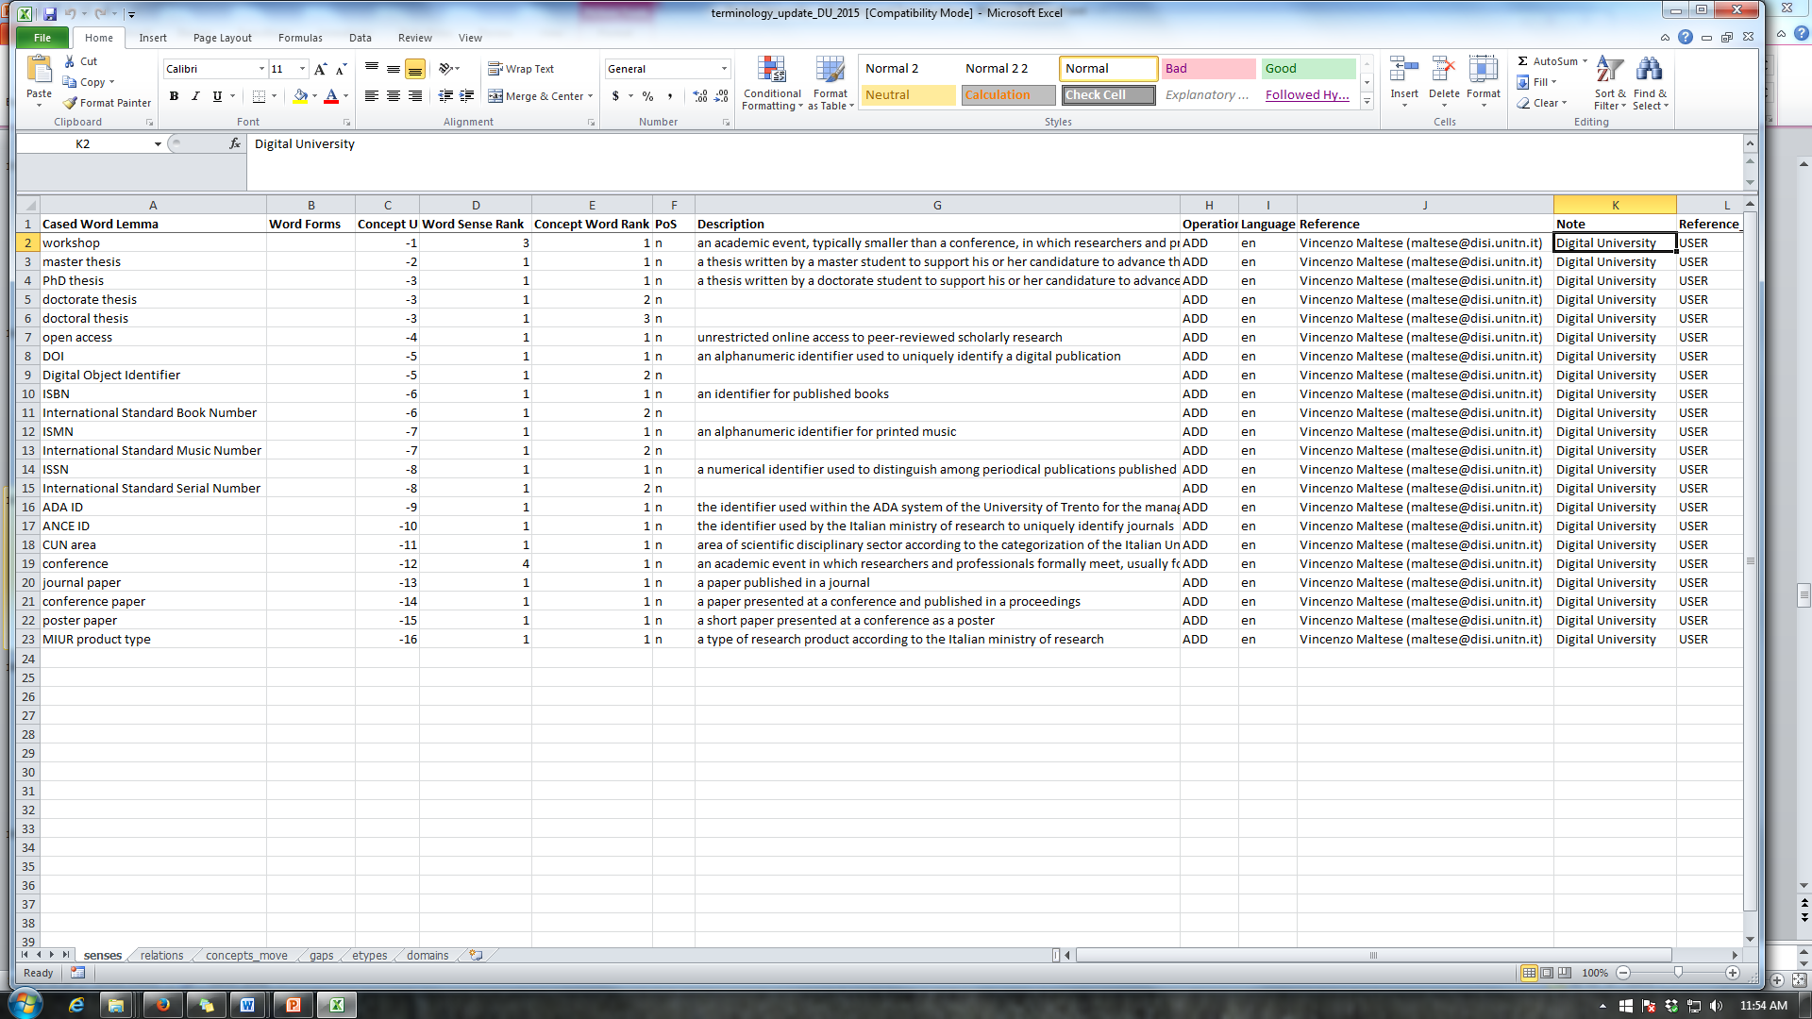
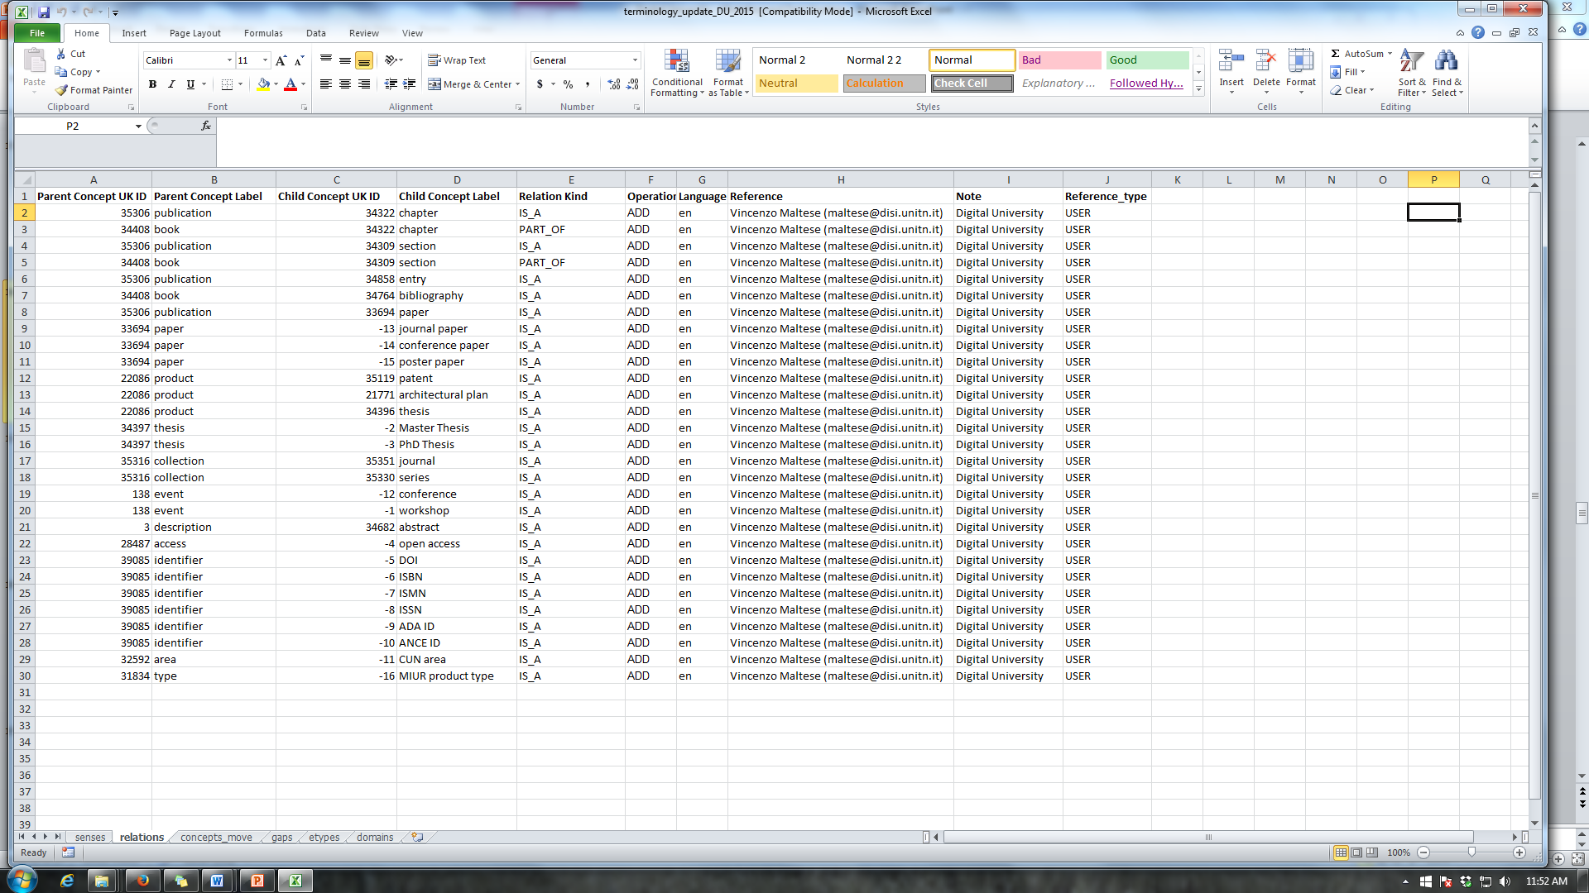
Technology: dashboards for the Data Scientist (5)
Vocabulary definition in batch mode

Slide 34
Thank you!
An overview of the solution to uniform digital services at SUSTech
Hao Xu
JLU
DIGITAL UNIVERSITY

